Slide 1
Facility Location using Linear Programming Duality
Yinyu Ye
Department if Management Science and Engineering
Stanford University

Slide 2
Facility Location Problem
Input
A set of clients or cities D
A set of facilities F with facility cost f_{i}
Connection cost C_{ij}, (obey triangle inequality)
Output
A subset of facilities F’
An assignment of clients to facilities in F’
Objective
Minimize the total cost (facility + connection)

Slide 3


Facility Location Problem

location of a potential facility
client



(opening cost)

(connection cost)


Slide 4
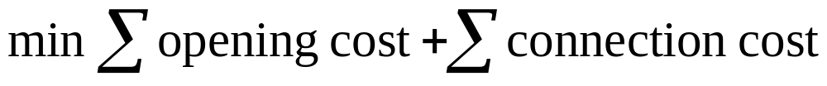
Facility Location Problem

location of a potential facility
client



(opening cost)

(connection cost)


Slide 5
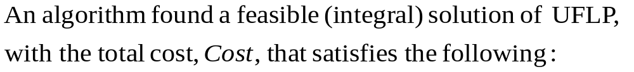
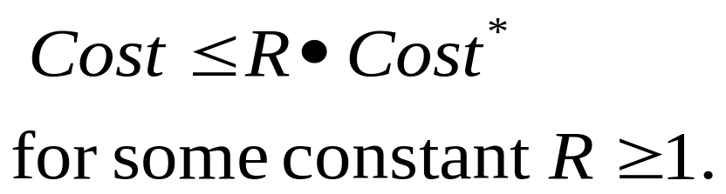
R-Approximate Solution
and Algorithm

Slide 6
Hardness Results
NP-hard.
Cornuejols, Nemhauser & Wolsey [1990].
1.463 polynomial approximation algorithm implies NP =P.
Guha & Khuller [1998], Sviridenko [1998].

Slide 7
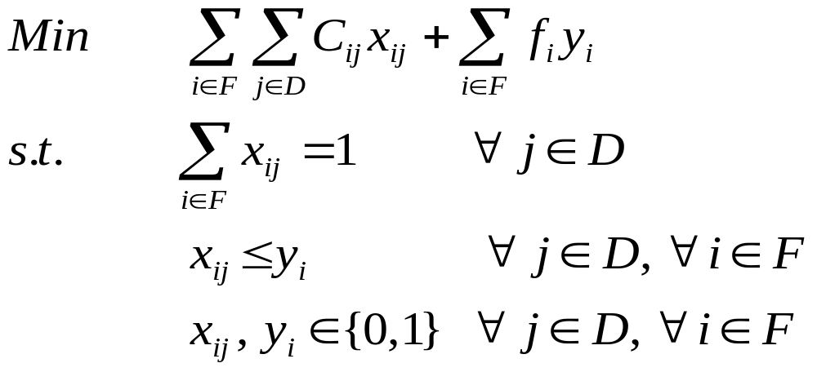
ILP Formulation
Each client should be assigned to one facility.
Clients can only be assigned to open facilities.

Slide 8
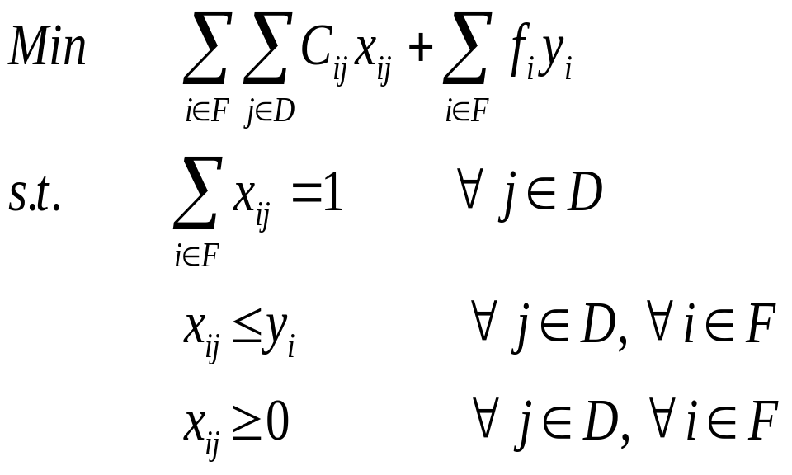
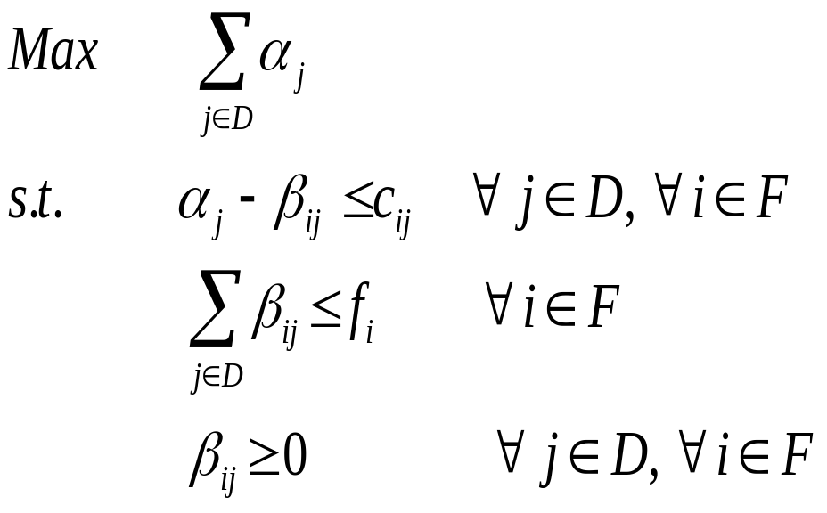
LP Relaxation and its Dual
Interpretation: clients share the cost to open a facility, and pay the connection cost.

Slide 9
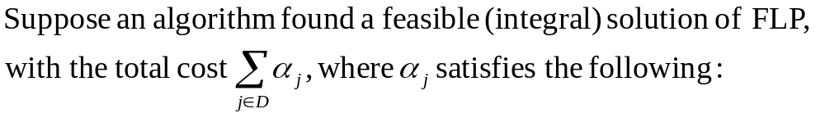
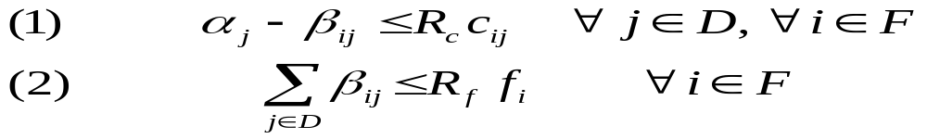
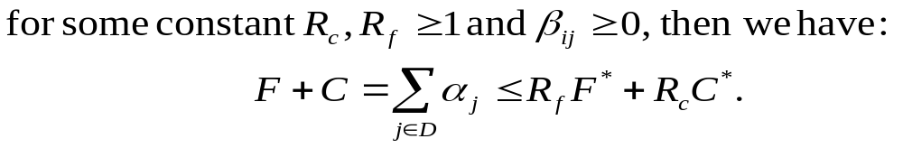
Bi-Factor Dual Fitting
A bi-factor (R_{f},R_{c})-approximate algorithm is a max(R_{f},R_{c})-approximate algorithm

Slide 10




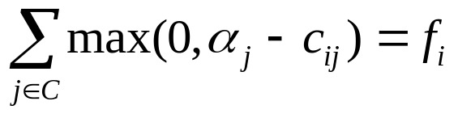

Simple Greedy Algorithm
Jain et al [2003]
Introduce a notion of time, such that each event can be associated with the time at which it happened. The algorithm start at time 0. Initially, all facilities are closed; all clients are unconnected; all set to 0. Let C=D
While , increase simultaneously for all , until one of the following events occurs:
(1). For some client , and a open facility , then connect client j to facility i and remove j from C;
(2). For some closed facility i, , then open
facility i, and connect client with to facility i, and remove j from C.

Slide 11
Time = 0
F1=3
F2=4
3
5
4
3
6
4

Slide 12
Time = 1
F1=3
F2=4
3
5
4
3
6
4

Slide 13
Time = 2
F1=3
F2=4
3
5
4
3
6
4

Slide 14
Time = 3
F1=3
F2=4
3
5
4
3
6
4

Slide 15
Time = 4
F1=3
F2=4
3
5
4
3
6
4

Slide 16
Time = 5
F1=3
F2=4
3
5
4
3
6
4

Slide 17
Time = 5
F1=3
F2=4
Open the facility on left, and connect clients “green” and “red” to it.
3
5
4
3
6
4

Slide 18
Time = 6
F1=3
F2=4
Continue increase the budget of client “blue”
3
5
4
3
6
4

Slide 19
Time = 6
F1=3
F2=4
The budget of “blue” now covers its connection cost to an opened facility; connect blue to it.
3
5
4
3
6
4
5
5
6

Slide 20


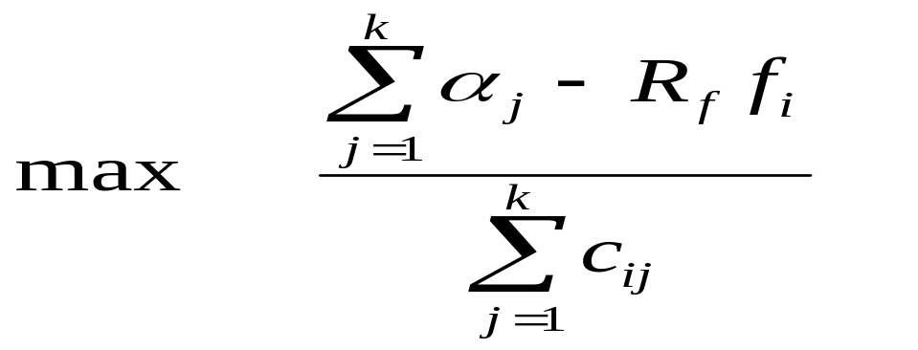
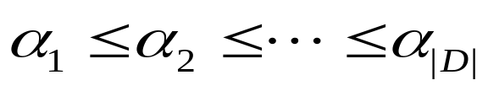
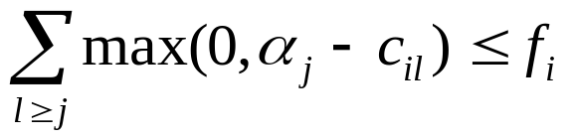
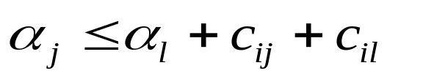
The Bi-Factor Revealing LP
Jain et al [2003], Mahdian et al [2006]
Given , is bounded above by
Subject to:
In particular, if

Slide 21
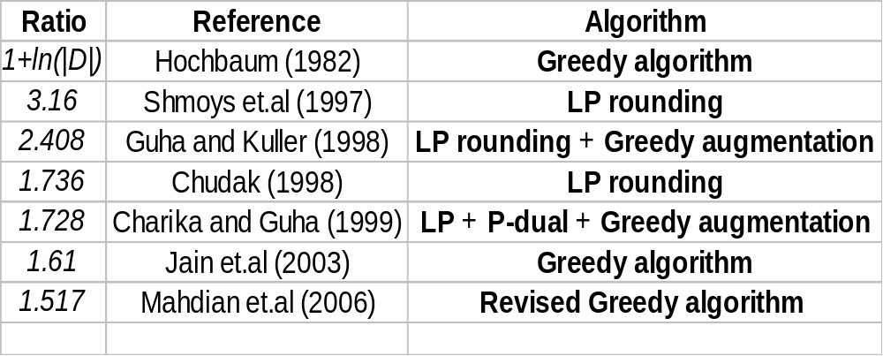
Approximation Results

